Slide 1
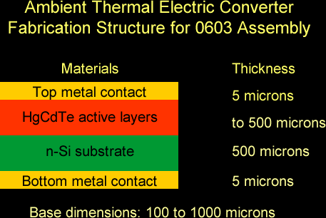
Ambient Thermal Electric Converter (ATEC)
What It Is
Our ATEC converts environmental heat directly to electricity without a cold side.
It makes use of quantum-mechanical behavior of electrons in semiconductors between materials of differing composition.
Stacks of sub-micron thick layers of selected semiconductor materials such as Mercury Cadmium Telluride (HgCdTe) generate persistent voltages across themselves, driven by differences in band gap.

Slide 2
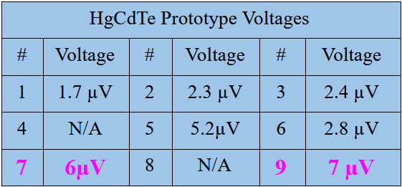
Stage of Development/ Intellectual Property
Prototypes exhibited their signature voltages - stable, repeatable. Serial connection of prototypes #7 and #9 added their voltages (to 13 microvolts).
These results are for a 4-cycle device (Slide #8 depicts a 2 ½ cycle device). Typical production versions may have 500 cycles to accumulate required voltages.
Based on positive test results from prototype ATEC devices of HgCdTe, we have reached TRL 3.
Thermawatts holds ATEC patents for the basic device in:
United States (US8624100)
People’s Republic of China (CN103201848B)
Republic of India (329930 - App no 3218/DELNP/2013)
Republic of China (TWI478406B).

Slide 3
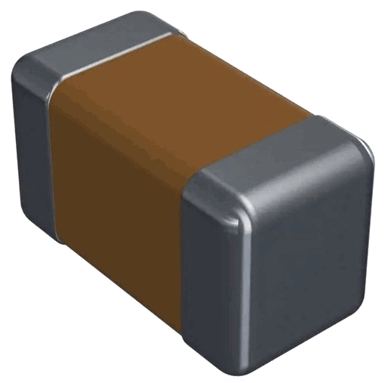
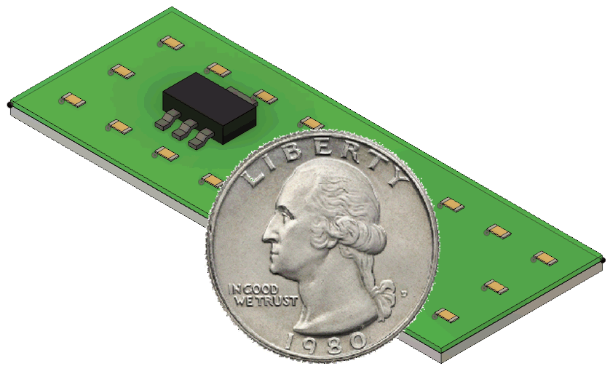
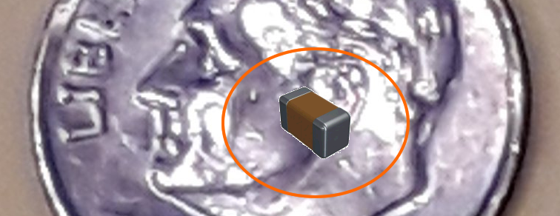
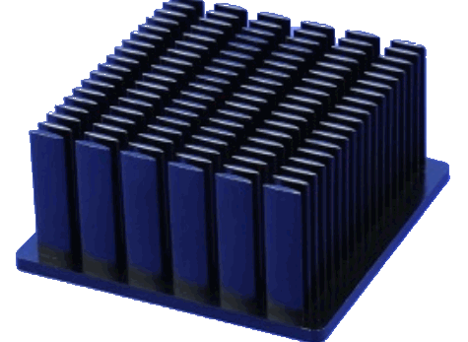
ATEC Application Packaging
Applications of ATECs will use industry standard form factors such as this 0603 device, which is 1.8 millimeters long. The 0603 is cheap (base cost of less than a penny to assemble) and made in billions. Some applications will use many of these, spread around to assist heat transfer.
A power supply for a remote sensor might look like this. The small yellow parts are ATEC parts in 0603 form. The green is a copper-clad PC mounting board. Multiple small parts are used to aid heat conduction. The black element is a voltage regulator.
0603 Part, containing ATEC structure
A power supply (or heat-absorbing) unit can be scaled from small to huge. A unit may be made of an array of devices spread around a heat sink of some kind (usually by use of many tiny devices to assist in heat transfer). Heat sinks might have ATECs arrayed and connected on their backs.

Slide 4
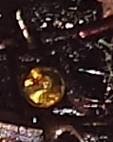
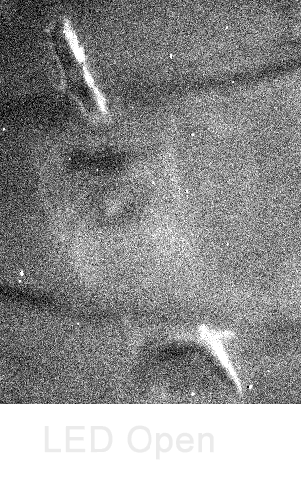
Zeroth Law Exceptions
Maxwell put forth the Zeroth Law of Thermodynamics (uniform temperature) to protect the Second Law against a class of exceptions. We have made three ground-breaking independent experiments on LEDs that show Zeroth Law exceptions.
On the left is a LED under normal light. On the right the same LED as seen by our highly sensitive camera. Blackbody radiation is a constant. The right image flips differ only by the connection to the LED - either open or with reverse bias. Under reverse bias, the LED active region is visibly darker. The light emitted by the LED at zero bias shows a temperature different from the bulk material, a violation of the Zeroth Law of Thermodynamics.

Slide 5
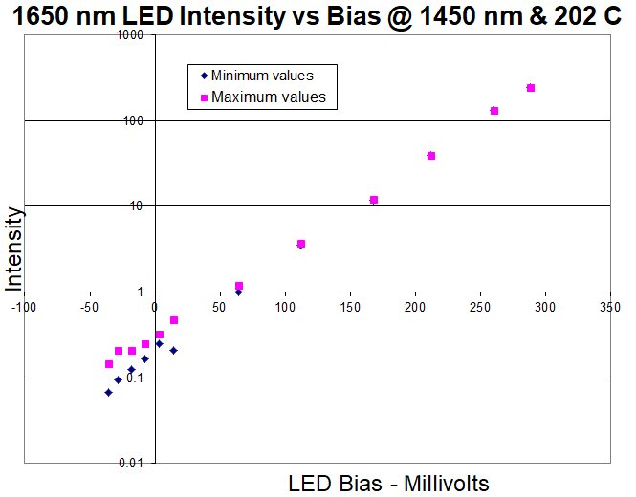
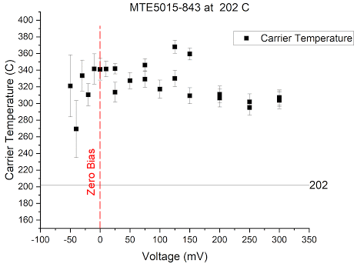
Zeroth Law Exceptions
We showed light emitted near and below zero bias can be well above the lattice temperature, a Zeroth Law violation. We set up a measurement system in an Oregon State University physics lab which measures light output from an LED while subtracting out blackbody radiation. Then we swept the LED with a bias voltage, crossing zero. From here, we could infer the electron temperature by measuring the emission spectrum.
This shows the computed carrier temperature.The extracted electron temperature plotted suggests the electrons are effectively hotter than the bulk material. The spectrum told us that there were two distinct temperatures within the LED, even at zero bias. Levy observed a similar effect in thermoelectric materials.

Slide 6
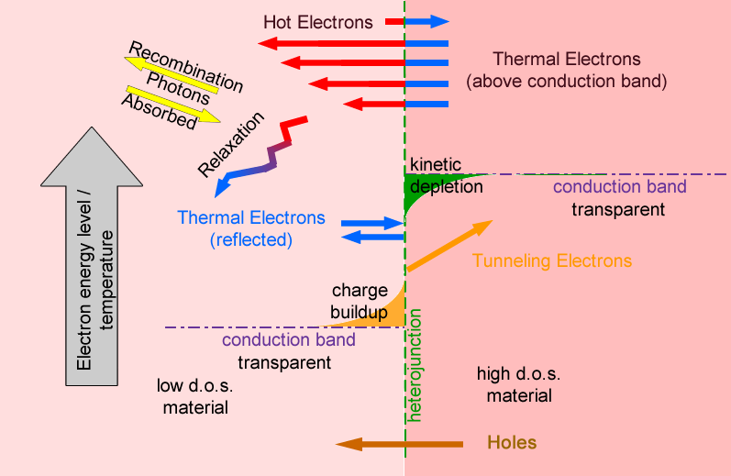
Technology - Electrons at
Semiconductor Heterojunctions
Operation of our device springs from two well-known features of semiconductors:
Differences in carrier densities-of-state between differing semiconductor compositions, by as much as two orders of magnitude.
Diffusion of free electrons from high to low densities-of-state materials, causing a standing voltage.
A dynamic equilibrium of charge is brought about by:
Electrons tunneling from the charge, and
Holes diffusing toward the charge
thus enabling further diffusion of free electrons to maintain the charge and flow.

Slide 7
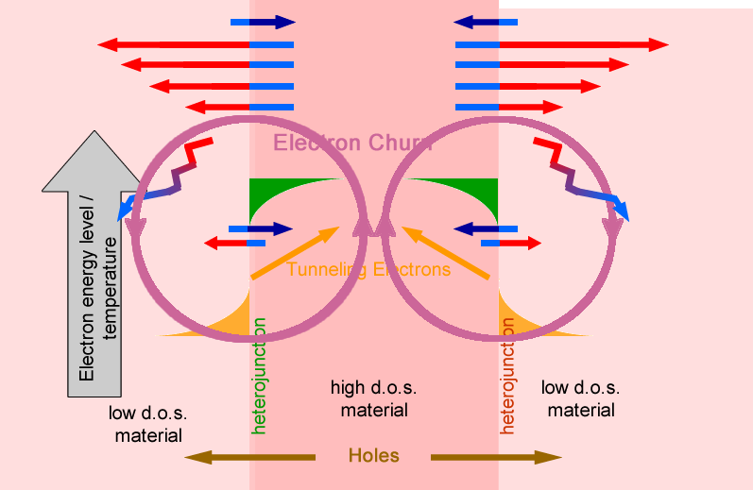
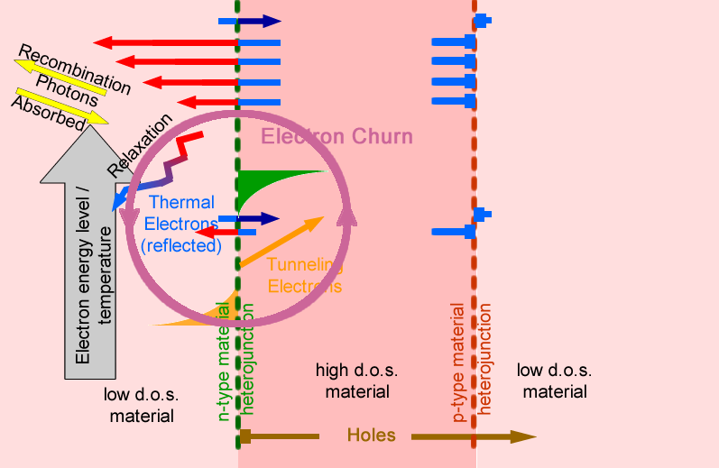
Technology - Doping Alternate Layers
Doping is key to creating a current. Alternately-doped layers between junctions forces electrons and holes to go opposite directions.
No Doping => no net electron flow
Alternate Doping => net electron flow

Slide 8
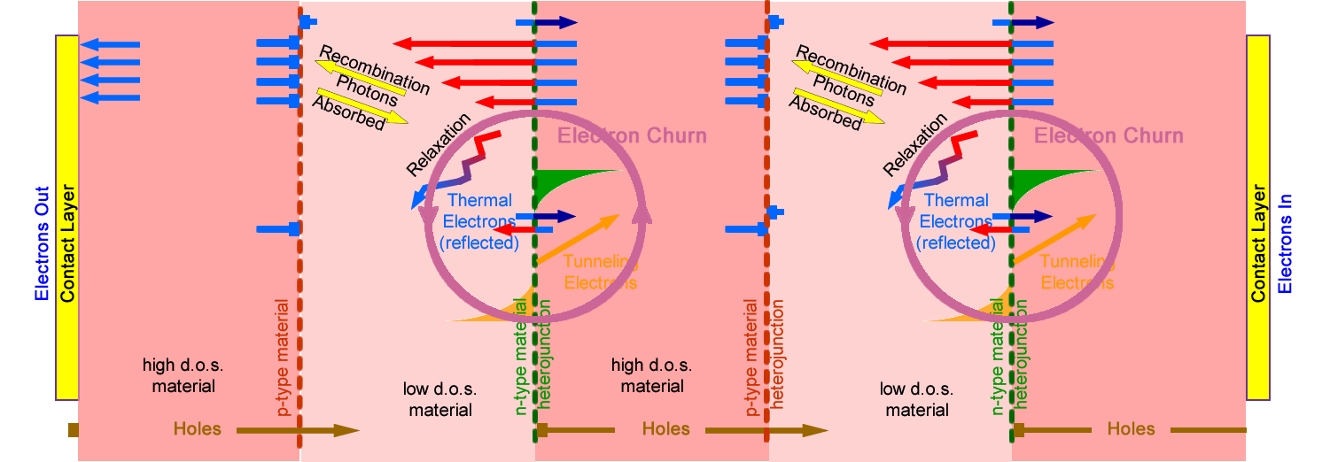
Technology - Repeated Cycles for a Power Supply
Here are 2 ½ cycles of the structure, with the churning of electrons indicated by the purple circles. Contacts are shown at the ends of the structure. Electrons flow to the left and leave by the contact layer. Holes flow to the right, absorbing electrons entering at that contact layer.

Slide 9
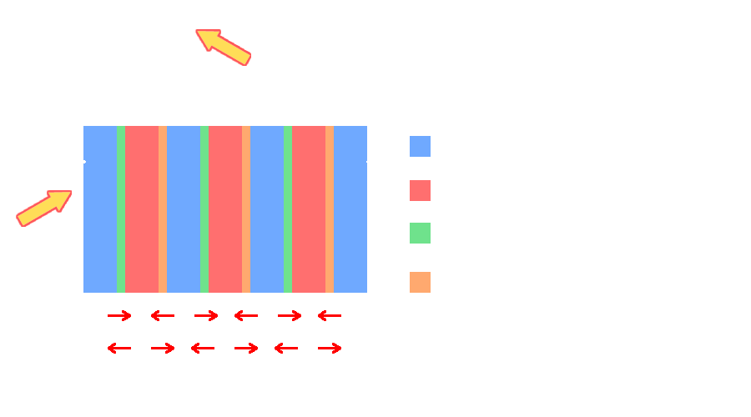
Technology - Heat Flows
The structure will replace the energy drawn from a load on it by absorbing heat from its environment. Thus, it converts environmental heat (at ambient temperature) and produces electricity with no other input. Details at https://www.youtube.com/watch?v=PBfKC-cKB-M .

Slide 10
ATEC Solution - Cost and Impact
An ATEC-based power supply can be scaled to watts, kilowatts, and megawatts for nearly any use of electricity.
Mass market uses extend to virtually any personal electronics, computers and servers, even industrial processes, lighting, heating and cooling (removing environmental heat). It will enable applications not practical with battery or hardwired power.
With costs near $0.007/KwH, it will completely disrupt the way we generate and distribute electricity, and will supplant most fossil fuel, mitigating climate change.
Levelized Cost of New Electricity Generation in 2025 Per U.S. Energy Information Admin.
Energy Source | $/ per Megawatt Hour
Coal | 76.44
Nuclear | 81.65
Geothermal | 37.47
Onshore Wind | 39.95
Solar PV | 35.74
Hydroelectric | 52.79
ATEC Technology* | 6.40
* Estimate by ThermaWatts, LLC

Slide 11
TRL 4 to Minimum Viable Product
Our eventual Minimum Viable Product is a 0.1 Watt ATEC power supply, encapsulated in 0603 packages. This is a component which can easily be incorporated into new and existing designs.
This work should bring development to TRL 4.
From TRL 4 forward, there are numerous competitive parties skilled at each step.
We will engage the existing U.S. electronics supply chain to produce power supply devices.
For assemblers of 0603’s and end-user products:
We have had discussions with two companies, each with sales >$100 million
With sufficient proof of device performance, they were prepared to complete production
We have heard strong interest from end-product designers to include our technology.
Previous work has been funded by the National Science Foundation $108,000 and the Orem Family $400,000.

Slide 12
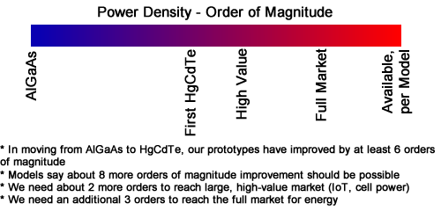
A Sufficient Level for MVP Performance
To invest, fabricators and assemblers need to see higher levels of prototype performance for their ATEC-based products to be viable.
They will need about 1 ½ more orders of magnitude to compete in initial large, high-value market (IoT, cell power)
They will need an additional 1 ½ orders to compete head-to-head on cost in the full energy market
Models say at least six orders improvement over previous prototypes should be possible.
The development steps identified below should get us to MVP level.

Slide 13
Work Plan
Prototype Enhancement
Our first objective is to improve the performance of prototypes of our device to MVP level of 200 microvolts for a four-cycle device. We have identified specific likely reasons for less-than-modeled performance. We will change prototype design and fabrication methods, have the new design fabricated, and then test the voltage and power outputs of the new prototypes under a range of temperatures.
We will make through-wafer connections, which will allow us to measure the voltage away from dead shorts and without the added impedance of the contact layer.
Figure shows past design and then design to remove short.
To further improve performance, we will add p-doped layers, apply passivation to reduce leakage down the mesa sizes, increase defects, and vary composition, doping levels, and layer thickness.

Slide 14
Project Risks and Mitigations
RISK | MITIGATION
Further prototype development indicated modeled performance cannot be achieved. | If MVP performance is not achieved in the identified five prototype rounds, the project should be dropped.
Devices work, but are not stable enough for broad range applications. | Focus project work to establish clear operating limits for high value uses
Even with high prototype performance, assemblers choose not to make initial outlays. | Apply for SBIR Phase II/III-like support or similar DoD, or venture capital, funding for initial assembly.
This use of HgCdTe is considered too toxic for widespread use. | Encapsulate. Limit application areas to high-value and critical military.

Slide 15
Values and Applications
Value Statement
The world needs clean, low-cost, low-risk, often portable, scalable technology to backfill fossil, nuclear, and even solar and wind generation. We need to reverse climate change. We need more equitable energy costs. We must eliminate geo-political conflict over energy and the resources it can make available.
Our direct ambient-heat-to-electricity conversion could fill much of those needs.

Slide 16
Values and Applications
Value Statement
For Internet of Things and and Consumer Electronics
Ready market in billions of units at 100 to 10,000 milliwatts
Economic even at low performance because of the high value of portability and self-charging
For Bulk Applications (e.g., heating, transportation, agriculture)
Clean
Predictable/dispatchable
Lower levelized cost than other energy sources
Improves lives through equity, comfort, and security

Slide 17
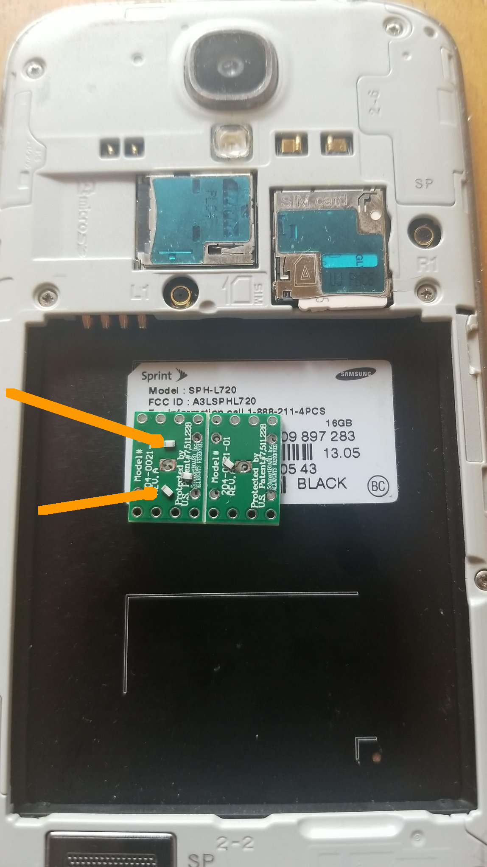
Values and Applications
Cell Phone Power
ATEC power supplies will replace cell phone batteries.
The orange arrows on the phone image point to two of the four 100 milliwatt 0603 parts on a circuit board.
A complete power supply might contain ten 0603’s, and then be packaged. The phone will not need recharging - ever.

Slide 18
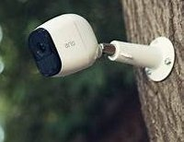
Values and Applications
Power for Security Systems
Security devices such as remotely-located motion detectors, cameras, strobe lights, and microphones are a large segment of the Internet of Things where ATEC power technology is a natural solution. Wireless, carefree power will encourage widespread use of such devices.

Slide 19
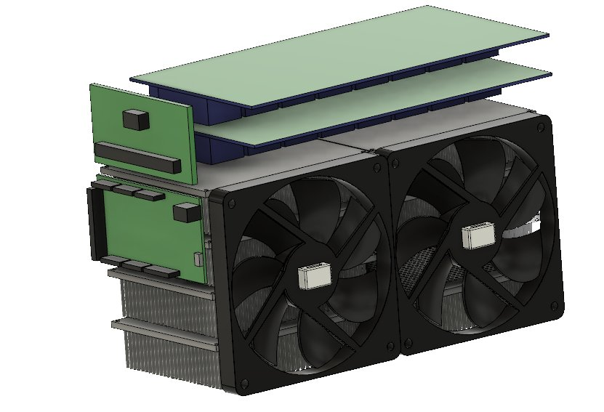
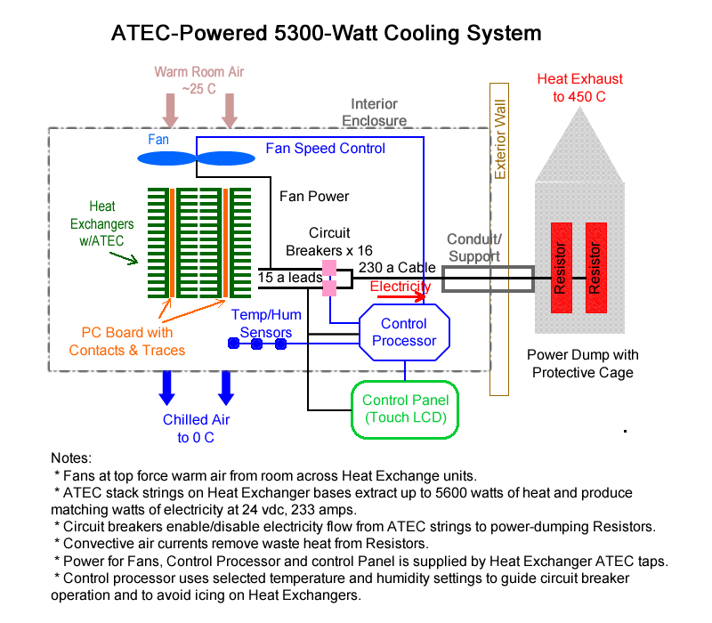
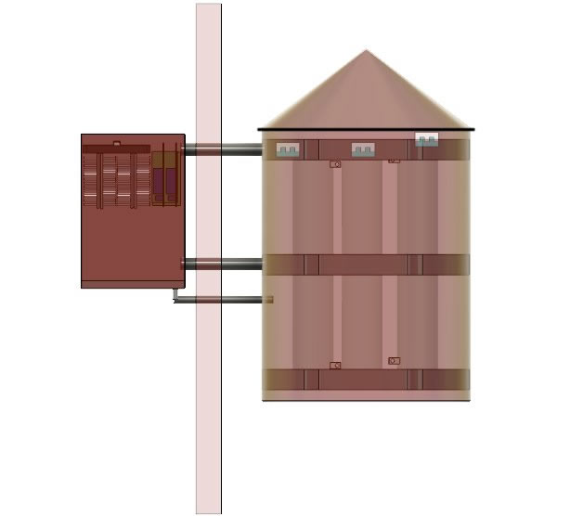
Values and Applications
Air Conditioning
ATEC technology could be used to drive apartment-sized air conditioning units, extracting both heat and moisture. The indoor package fits into less than 1 cubic foot. Harvested electricity is sent to grid or expelled in a heat dump.

Slide 20
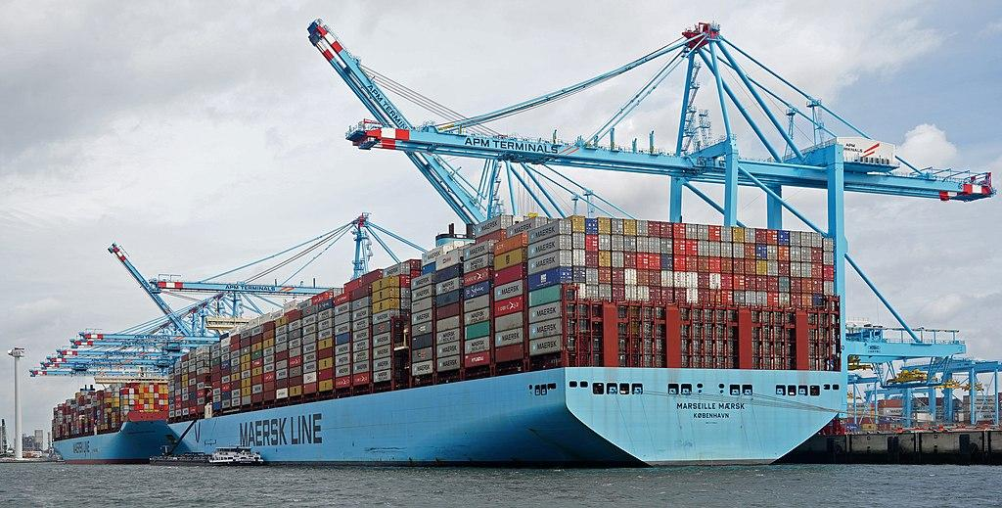
Values and Applications
Container Ship Power
With container shipping producing about 3% of total GHG emissions, it is a prime target for using fuelless ATEC technology. 50 to 60% of Golden Class operating cost is for fuel.
A ship uses 60 megawatts for propulsion. Its below-water skin is 36,000 square meters.
Using 67% of its below-water skin for transferring heat to ATEC devices, it could draw enough heat at 1 ℃ above melt to achieve full speed. By limiting routes to somewhat warmer waters - say, 5 ℃ above melt, heat transfer area could be reduced to under 14%, thereby reducing first costs.
https://commons.wikimedia.org/wiki/File:MAERSK_MC_KINNEY_M%C3%96LLER_%26_MARSEILLE_MAERSK_(48694054418).jpg

Slide 21
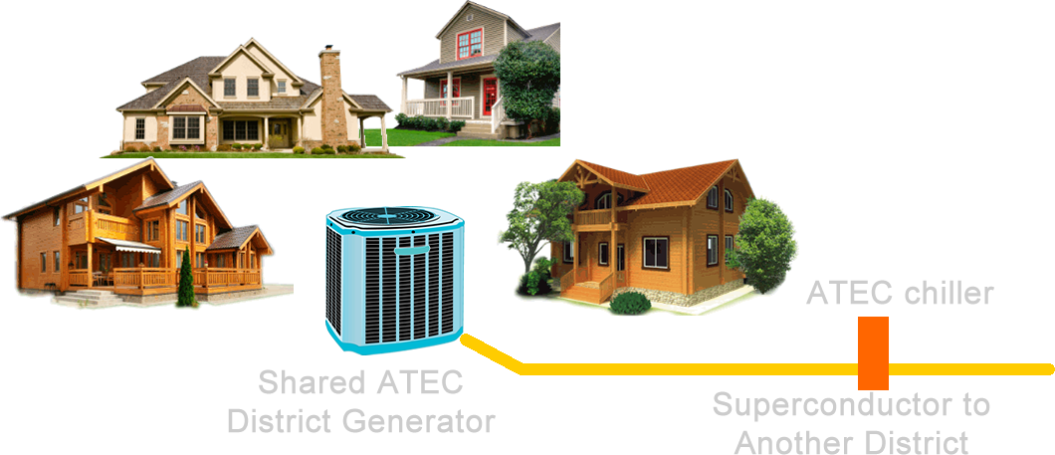
Values and Applications
Microgrids and Districts
Clusters of uses, such as within a home or military field operation, could be served by ATEC-based power supplies/coolers. Each cluster could be further served with shared generation to provide backup and take advantage of load diversity. Shared generation could be links to other shared generation by superconductor cooled by ATEC devices.
Very large scale generation is limited by local cooling effects.

